Slide 1
EFMRP Protocol
Sustainable message forwarding in Wireless Sensor Networks

Slide 2
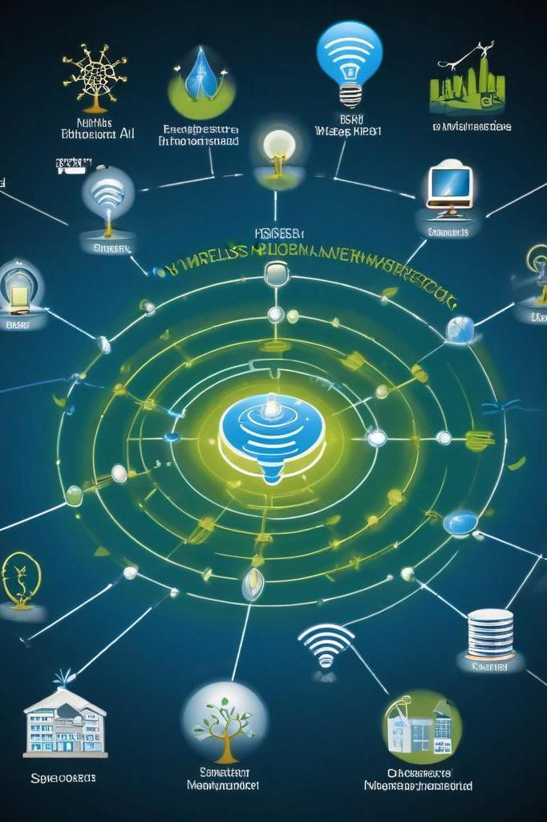
Introduction
Wireless Sensor Networks (WSNs) are crucial for monitoring environments where human presence is minimal. Key challenges include energy constraints and the impact of environmental factors like wildfires. While many existing protocols prioritize energy efficiency, they often overlook these environmental impacts. The Environment-Fusion Multipath Routing Protocol (EFMRP) aims to bridge this gap by integrating depth, energy, and environmental data for enhanced message forwarding.

Slide 3
01
Key Components

Slide 4
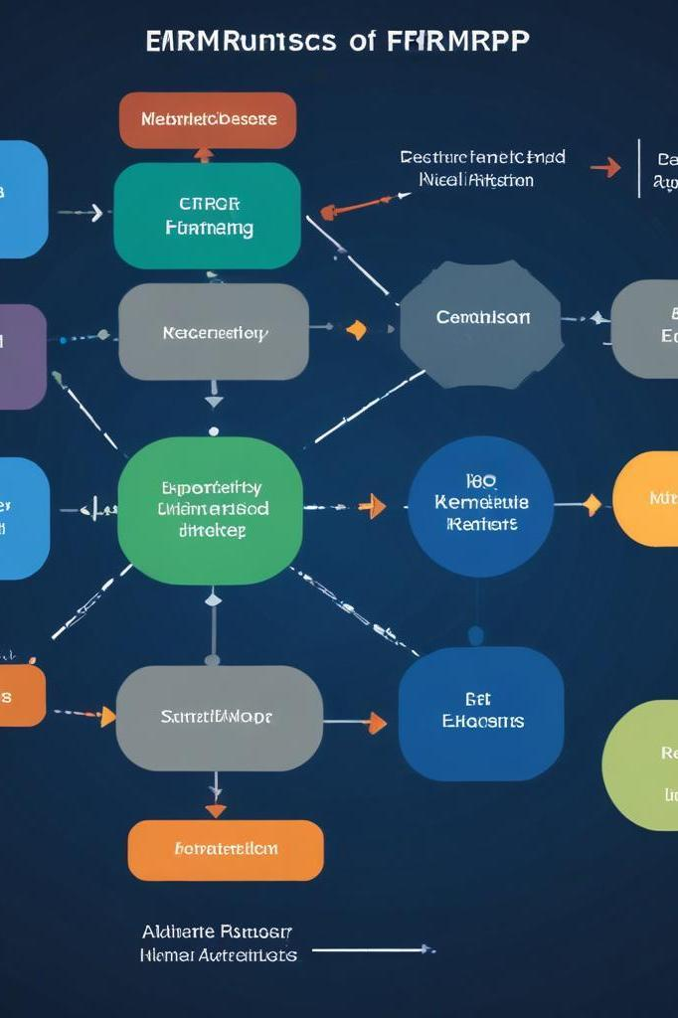
Potential Fields: Depth, Energy, Environmental
EFMRP utilizes three potential fields to guide message forwarding. The Depth Field directs packets towards the sink while considering the distance. The Energy Field identifies nodes with residual energy to avoid overusing low-energy nodes, enhancing overall network longevity. The Environmental Field assesses real-time hazards, guiding packets away from danger zones such as fire-prone areas, ensuring safer routing under adverse conditions.

Slide 5
Multipath Routing: Importance and Strategy
Multipath routing is a critical aspect of EFMRP as it establishes multiple independent paths for message delivery. This approach prevents single points of failure within the network, ensuring reliable communication even when certain paths become unusable. By balancing energy consumption across different routes, EFMRP improves the longevity and efficiency of wireless sensor networks. The strategy also adapts dynamically to network conditions, optimizing route selection in real-time.

Slide 6
Maintenance Mechanism: Local and Global
EFMRP includes a robust maintenance mechanism that ensures the network's reliability and efficiency. Local maintenance is initiated when nodes with low energy levels send alerts to their neighbors, prompting a response to address energy depletion. Global maintenance, on the other hand, adapts paths dynamically based on real-time environmental conditions and node performance. This dual approach minimizes disruptions in communication, maintains efficient routing paths, and extends the operational life of the network even under challenging conditions.

Slide 7
02
Protocol Comparison

Slide 8
Overview of EFMRP and its Advantages
The Environment-Fusion Multipath Routing Protocol (EFMRP) is designed to enhance the performance of wireless sensor networks by considering environmental factors and energy levels. EFMRP is distinct in its ability to adapt based on the surrounding conditions, making it an energy-efficient and environmentally aware solution. The key advantages include improved packet delivery ratios, extended network lifetime due to better energy management, and increased reliability in communication even in adverse conditions, making it a versatile choice for various applications.

Slide 9
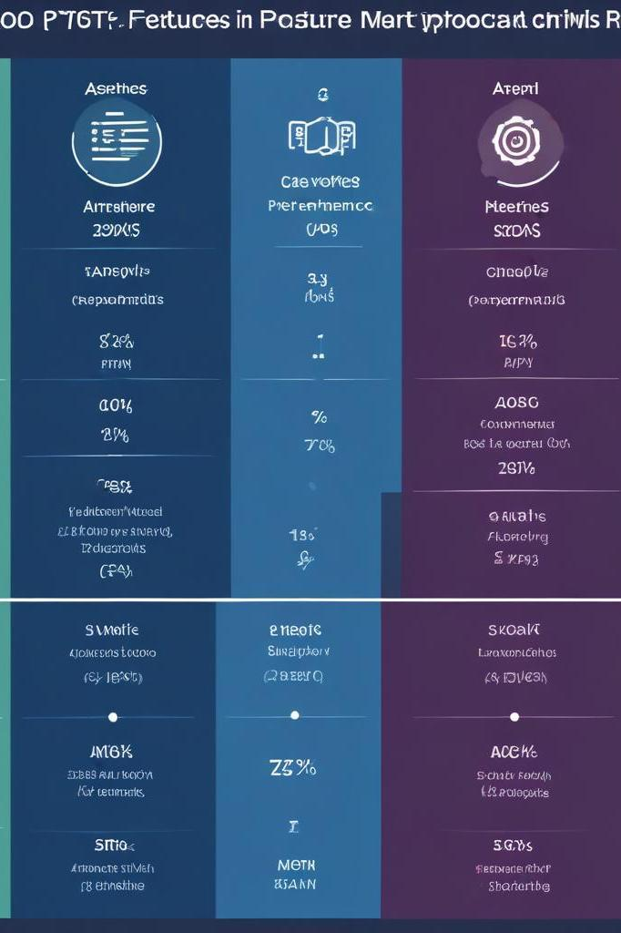
Comparison with SGF and AODV
When comparing EFMRP with other routing protocols like SGF (Smart Greedy Forwarding) and AODV (Ad-hoc On-Demand Distance Vector), significant differences are evident. SGF focuses predominantly on energy efficiency, often neglecting environmental factors, while AODV prioritizes the shortest path, which may not always be the most reliable. In contrast, EFMRP incorporates multiple routing paths and environmental awareness, providing a balanced solution that enhances overall network performance, especially in challenging settings.

Slide 10
Performance Metrics: PDR, Network Lifetime, Latency
Performance metrics are essential for assessing the effectiveness of routing protocols. EFMRP significantly improves the Packet Delivery Ratio (PDR) by using multipath routing, ensuring that messages reach their destinations even in harsh conditions. It also extends the Network Lifetime by balancing energy consumption across multiple paths, minimizing node failure occurrences. However, a trade-off exists, as EFMRP may exhibit slightly higher latency than shortest path protocols, which is compensated by its enhanced reliability and adaptability to dynamic environments.

Slide 11
Conclusions
The Environment-Fusion Multipath Routing Protocol (EFMRP) offers a comprehensive solution for wireless sensor networks, addressing both energy efficiency and environmental impact. Its integrated approach enhances packet delivery reliability and extends network lifespan by utilizing energy-aware and path-diverse strategies. Future enhancements include parameter optimization for varied network scenarios and adaptable strategies for multi-sink networks, ensuring that EFMRP remains at the forefront of technological advancements in WSNs.

Slide 12
Thank you!
Do you have any questions?
Do you have any questions?

